Slide 1
A Study on Consumer Preference for Digital Payment Methods and Applications
Field project
Name:Shreya.R.Gurav
RollNo.:MSAS105

Slide 2
Table of Contents
Introduction
Literature Review
Objectives
Data & Methodology
EDA
Data Analysis
Reliability Analysis
Hypothesis Testing
Correlation Analysis
Qualitative Analysis
Limitations
Conclusion

Slide 3
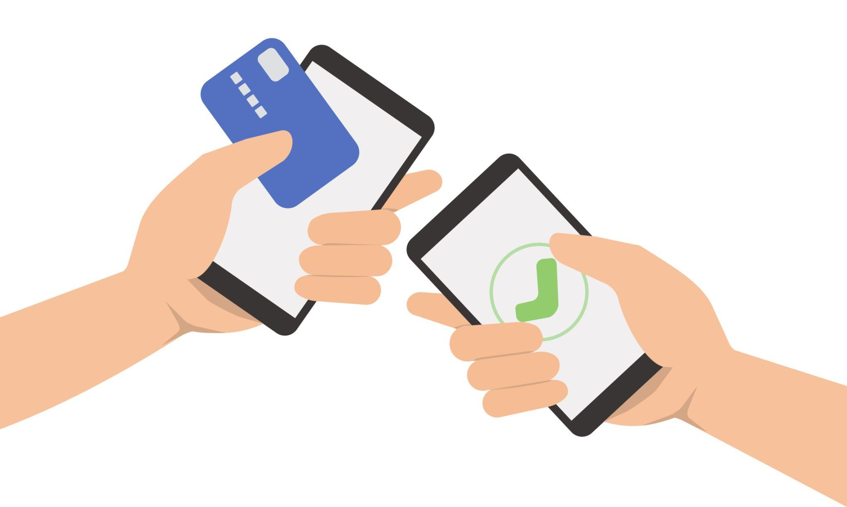
Introduction
Digital payment systems have rapidly transformed financial transactions
in recent years
Increased smartphone and internet usage have boosted digital adoption
Common payment methods include:
UPI
Debit/Credit Cards
Net Banking
Mobile Wallets
Various digital payment applications such as mobile apps are widely used for transactions
In India, digital payments have grown due to convenience, speed, and government initiatives
Consumer preference is influenced by factors like convenience, security, ease of use, and rewards
This study focuses on understanding consumer preference for both payment methods and applications

Slide 4
Literature Review
Various studies show that digital payment adoption has increased due to smartphone usage, internet access, and cashless transaction trends.
Zehra et al. (2024) found that convenience and ease of use are major factors influencing consumer preference for digital payment gateways in India.
The study also highlighted that security and trust strongly affect users’ choice of payment platforms.
Cashback and reward offers encourage continued usage and improve satisfaction.
Demographic factors such as age, education, and income also influence consumer behaviour toward digital payments.
The present study extends earlier work by using primary data and additional statistical analysis to understand consumer preference

Slide 5
Objectives
To identify the most preferred digital payment method among consumers
To determine the most preferred digital payment application
To analyze the frequency of digital payment usage
To examine the influence of:
Cashback & rewards
To identify the most important factor affecting consumer preference
To examine whether age group influences digital payment preference
Convenience
Ease of use
Security

Slide 6
Data & Methodology
Data
Source: Primary data (Google Forms)
Sample Size: 159 respondents
Data Includes:
Demographic details (Age group)
Payment usage behaviour
Preferred methods & applications
Influencing factors (Likert scale)
Open-ended responses
Methodology
Steps:
Data Cleaning & Preparation
Exploratory Data Analysis (EDA)
Statistical Techniques:
Descriptive Statistics
Cronbach’s Alpha (Reliability Test)
Fisher’s Exact Test
Correlation Analysis

Slide 7
Data Preprocessing
Imported dataset and reviewed structure
Cleaned and standardized column names (removed extra spaces)
Checked for missing values and handled appropriately
Encoded categorical responses where required
Organized Likert-scale responses into numerical format
Ensured dataset is ready for statistical analysis

Slide 8
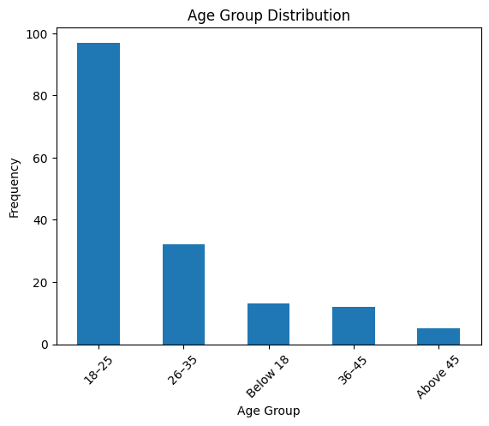
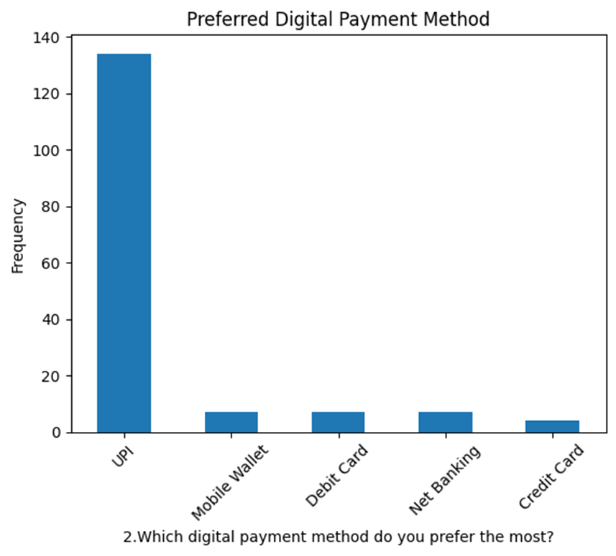
EDA
Visualized data using charts and graphs
Identified key patterns and trends in user behaviour
Analyzed age group distribution of respondents
Identified most used digital payment methods (UPI, cards, wallets)

Slide 9
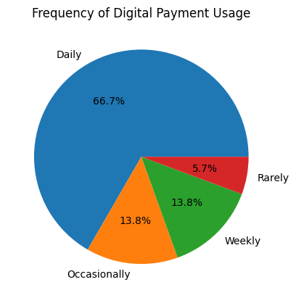
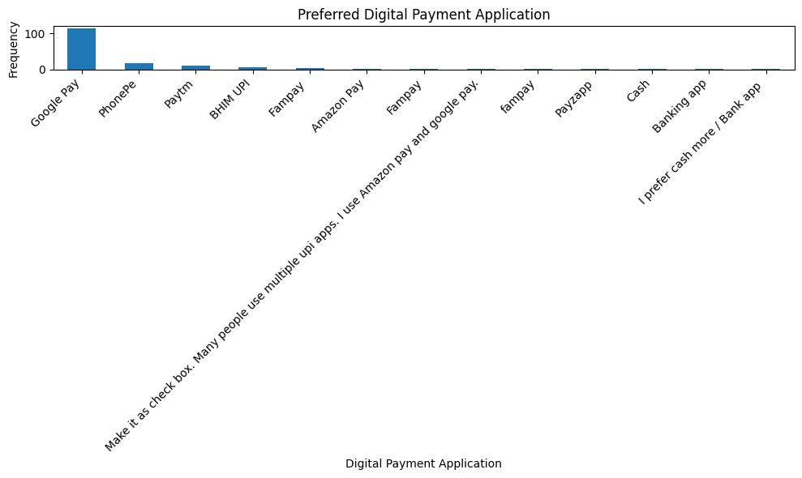
EDA
Examined preferred payment applications
Studied frequency of digital payment usage

Slide 10
Reliability Analysis
Used Cronbach’s Alpha to test internal consistency
Applied on Likert-scale factors:
Convenience
Ease of use
Security
Cashback & rewards
Cronbach’s Alpha = 0.739
Indicates acceptable reliability (0.7 – 0.8 range)
Questionnaire is consistent and suitable for analysis

Slide 11
Hypothesis Testing
Hypothesis
H₀: No association between age group and payment method
H₁: Association exists between age group and payment method
Chi-Square Test
Used to test association between categorical variables
Assumption: Expected frequencies should be sufficient (>5)
In this study, assumption was violated (many cells < 5)
Hence, Chi-Square result is not reliable
Fisher’s Exact Test
Used as an alternative to Chi-Square
Suitable for small sample / low expected frequencies
Result:
p-value = 0.0092
p < 0.05 → Reject H₀

Slide 12
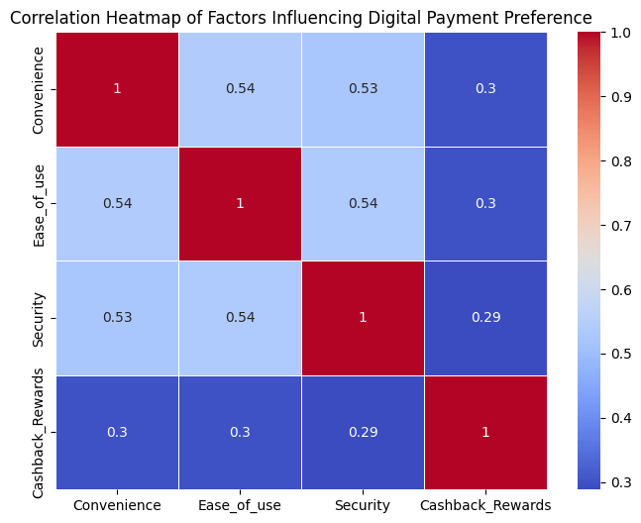
Correlation Analysis
Analyzed relationship between:
Convenience
Ease of use
Security
Cashback & rewards
Used correlation matrix and heatmap for analysis
All factors show positive correlation
Convenience and ease of use show relatively stronger correlation
Indicates that factors are interrelated and influence each other
These factors collectively impact consumer preference for digital payment

Slide 13
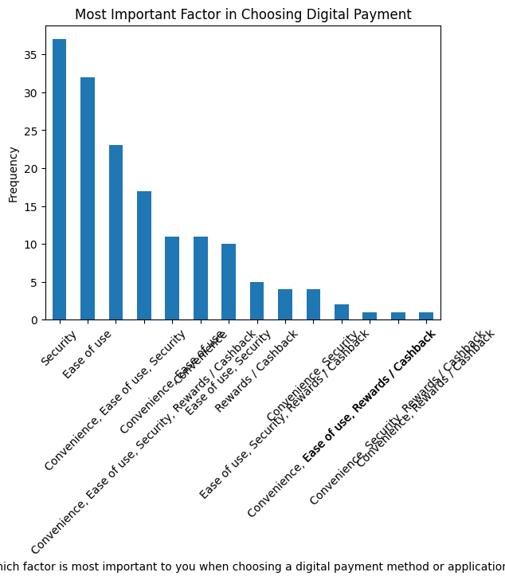
Most Important Factor
Respondents were asked to identify the most important factor influencing their payment choice
Factors included:
Convenience
Ease of use
Security
Cashback & rewards
Analysis was done using frequency distribution and bar graph
Convenience was selected by the majority of respondents
Ease of use and security were also important but ranked lower
Cashback and rewards had comparatively less influence
Indicates that users prefer simple, fast, and reliable transactions over incentives

Slide 14
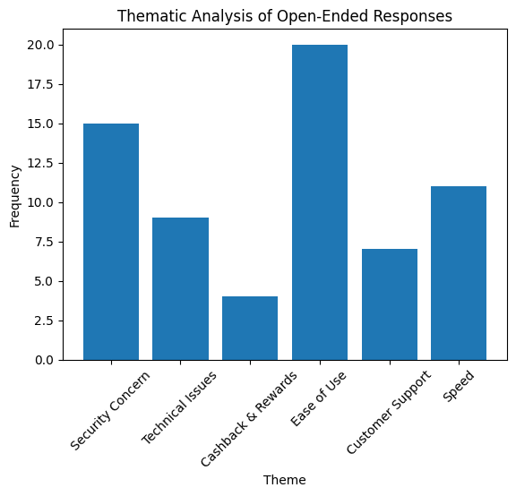
Qualitative Analysis (Open-Ended Responses)
Ease of use is the most frequently mentioned factor by respondents
Security concerns are also highly reported, indicating trust issues
Speed of transactions is another important positive factor
Some users reported technical issues affecting experience
Customer support is moderately mentioned by users
Cashback & rewards are least mentioned, showing lower importance
Overall, users prefer easy, fast, and secure digital payment systems

Slide 15
Limitations
Study based on a limited sample size (159 respondents)
Use of convenience sampling may affect representativeness
Data is self-reported, may include response bias
Likert-scale data treated as numerical for analysis
Limited factors considered (other influences not included)
Some statistical assumptions (Chi-Square) were violated

Slide 16
Conclusion
Digital payment systems are widely adopted, especially among younger users
UPI and mobile payment applications are the most preferred methods
Users perform digital payments frequently, indicating high dependency
Convenience, ease of use, and security are the key influencing factors
Cashback and rewards have comparatively lower impact
Significant association found between age group and payment method
Correlation and qualitative analysis show preference for easy, fast, and secure payment systems

Slide 17
BIBILOGRAPHY
RESEARCH PAPER:
Zehra, F., Khan, F. S., Mazhar, S. S., Akhlaque, N., Haque, E., & Singh, A. (2024). Exploring consumer preferences and behaviour toward digital payment gateways in India. International Journal of Experimental Research and Review, 41(Spl Vol), 158–167.
Questionnaire link:
https://docs.google.com/forms/d/e/1FAIpQLSeKPhQ35HsHl21uRgcyUe41MXshITlQHyQKq6ene8Ngaq6uGQ/viewform

Slide 18
Thank you!!
Any Questions??

